Slide 1

ARTIFICIAL INTELLIGENCE & CONSTRAINT SATISFACTION
PuzzleMind
Interactive CSP & Search Visualization Suite
Backtracking
MRV Heuristic
Forward Checking
Domain Pruning

Slide 2

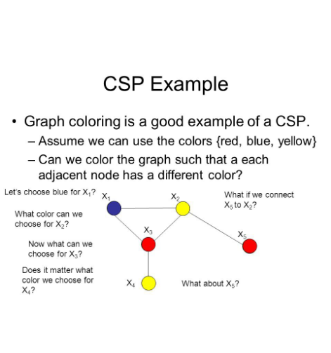
01. OVERVIEW
Project Abstract
Interactive Web Solver Suite
Exposes internal AI solver decisions, candidate domains, conflicts, and pruning live.
Four Core Puzzle Domains
Unified support for Sudoku, N-Queens, Map Coloring, and Kakuro solvers.
Heuristic Space Reduction
Demonstrates search space compression via MRV variable ordering and Forward Checking.

Slide 3



02. MOTIVATION
Problem Statement & Solution
Traditional Solvers
PuzzleMind Solution
Display only final matrix outputs without exposing search paths.
Connects theoretical mechanics with real-time visual step execution.
Hide variable selection logic, domain reductions, and backtrack causes.
Renders candidate domain changes and search trees step-by-step.
Theoretical heuristic algorithms remain black-box models for learners.
Quantifies heuristic impact with live node and backtrack metrics.

Slide 4




03. FOUNDATIONS
Literature Survey & Core Concepts
CSP Formalization
Backtracking Search
Models complex logic via variables, discrete domains, and explicit binary constraints.
Systematically assigns values and reverts state instantly upon constraint violation.
MRV Heuristic
Forward Checking
Prioritizes unassigned variables with the smallest remaining valid candidate choices.
Prunes invalid candidate values from neighbor domains before assignment fails.

Slide 5
04. CORE OBJECTIVES
Research Gap & System Objectives
Identified Research Gap
PuzzleMind Objectives
• Single Puzzle Focus: Educational tools rarely offer multi-puzzle unified visualization.
✓ Unified Platform: Solves Sudoku, N-Queens, Map Coloring, and Kakuro.
• Theoretical Metrics: Heuristic efficiency is described abstractly rather than demonstrated visually.
✓ Step Playback: Replays solver timelines with pause, step, speed, and reset controls.
• Opaque Execution: Rejection rationale and domain pruning events remain unexposed to users.
✓ Measurable Stats: Quantifies nodes explored, backtracks, and pruned domain candidates live.

Slide 6




05. SYSTEM ARCHITECTURE
Architecture & Tech Stack
Frontend Presentation Layer
React + Vite interactive puzzle boards and controls
CSP Solver Engine
Recursive solver with MRV heuristics & constraint evaluation
Visualization Event Stream
Event emitter rendering domain updates & search metrics

Slide 7
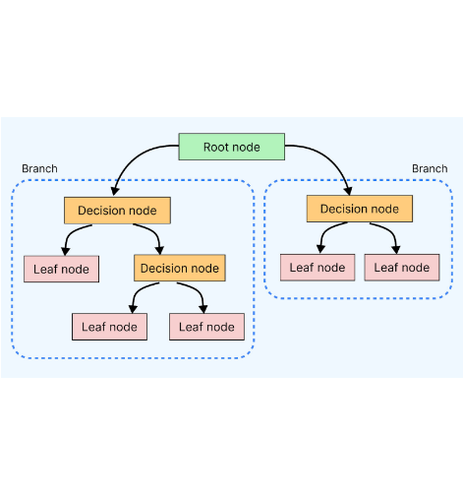
06. ALGORITHM EXECUTION
Proposed Solver Algorithm
1
Represent puzzle as variables, domains, and constraints.
2
Select unassigned variable using MRV heuristic.
3
Assign candidate values and verify constraints.
4
Apply Forward Checking to prune neighbor domains.
5
Backtrack on conflict; repeat until complete.

Slide 8
07. SCOPE & FEATURES
Implementation Features & Scope
Implementation Features
Scope & Future Directions
• Event-Driven Stream: Real-time decision logs streamed asynchronously to the React state.
• Educational Scope: Optimized for clear visualization over raw high-throughput solving speed.
• Interactive Controls: Supports Start, Pause, Step Next, Speed Slider, and Board Reset.
• High Event Density: Large puzzle instances generate extensive event logs during playback.
• State Inspection: Displays candidate domains, active constraints, and current depth level.
• Future Directions: Custom user board creation, Arc Consistency (AC-3), and benchmark exports.

Slide 9

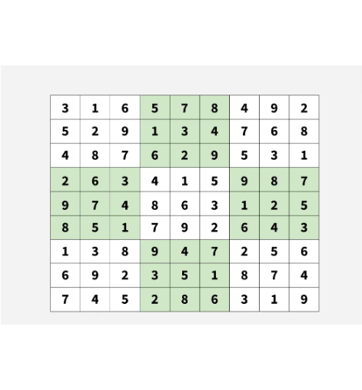
08. EXPERIMENTAL PERFORMANCE
Sudoku Solver Benchmark Comparison
4,209
52
Basic Backtracking Nodes
MRV Explored Nodes
98.7% Tree Reduction
102 candidate values pruned live via Forward Checking in benchmark test.

Slide 10




09. INTERACTIVE MODULES
Implemented Puzzle Suite
Sudoku
N-Queens
9x9 grid constraint checking with MRV variable selection and candidate domain overlays.
Non-attacking queen placement on N×N boards highlighting row and diagonal conflict lines.
Map Coloring
Kakuro
Adjacency graph vertex coloring demonstrating forward checking neighbor domain pruning.
Mathematical cross-sum logic puzzles combining arithmetic sum constraints with unique digit rules.

Slide 11


Conclusion & Key Takeaways
PuzzleMind bridges abstract CSP theory with an interactive, step-by-step visual exploration engine.
Core Achievement
Educational Impact
Demonstrated 98%+ search tree compression via intelligent MRV ordering and forward pruning.
Provides transparent visual feedback on backtracks, choices, and candidate domain states.

